Slide 1
AT80ED Scope
Brief Assessment
Cleaning
Initial Observations

Slide 2
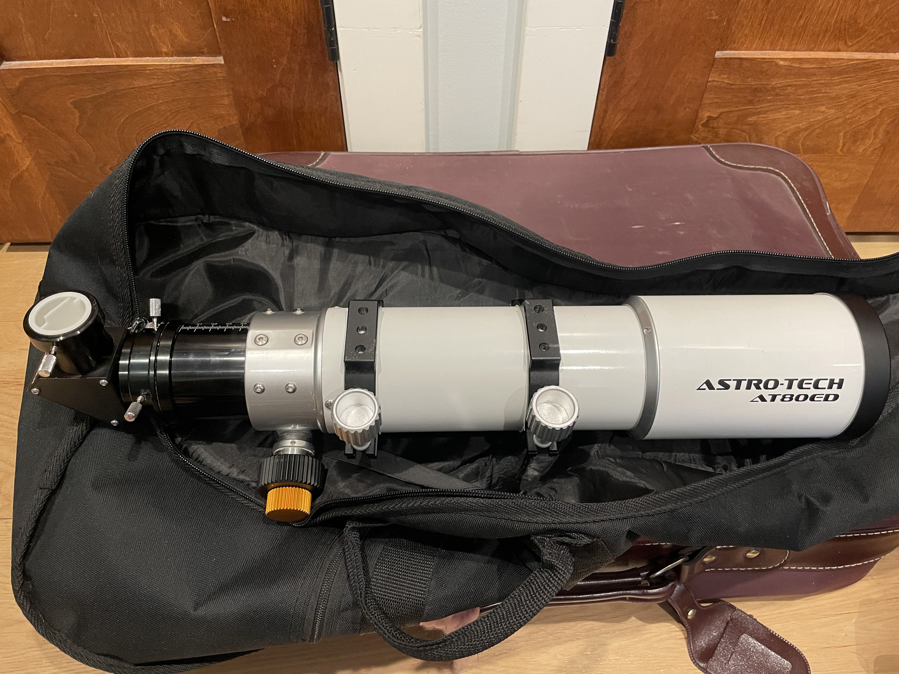
Initial External View of AT80ED
The scope appeared to be in good shape.
We were told there was internal OTA issues due to storage without a diagonal end cap (photo shows one we placed). An objective lens cap was present but the 80mm lens had dust and scratch issues.
No case came with scope (the one in photo is a guitar case I had).
Focusing knobs (coarse and fine) worked smoothly as did the retractable dew shield; mounting rings and Vixen style dovetail plate were intact.
All small lock knobs, screws etc. were present.
The focuser did not rotate nor was a locking collar present.

Slide 3
Identification of external parts (from manual)

Slide 4
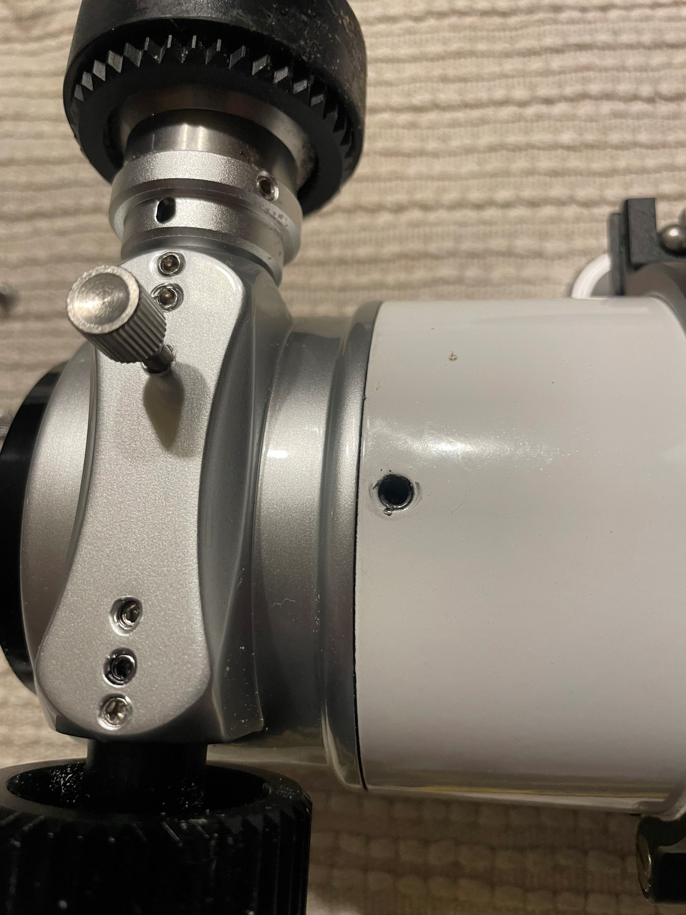
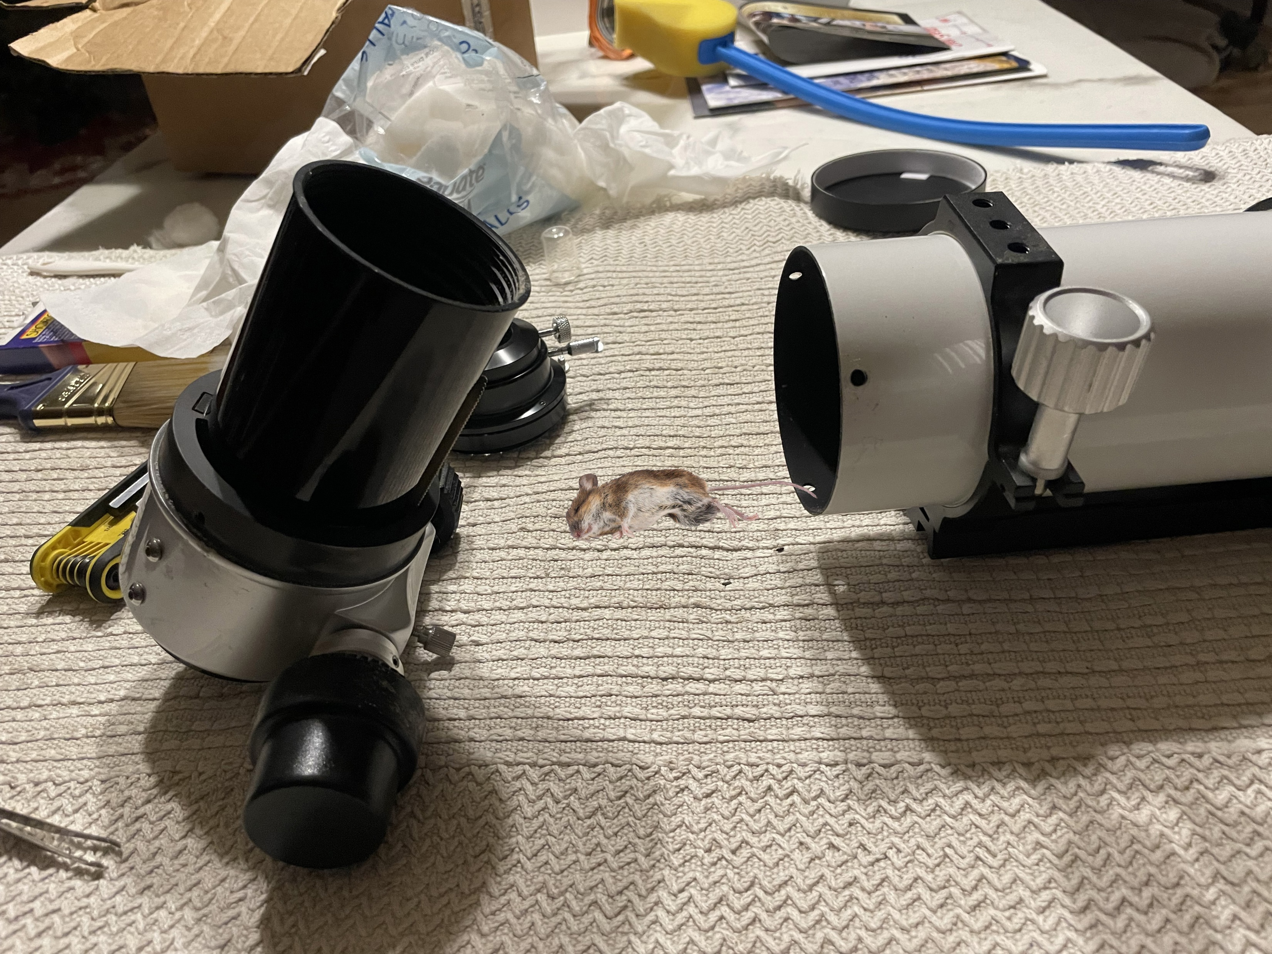
Opening the AT80ED optical tube

Slide 5
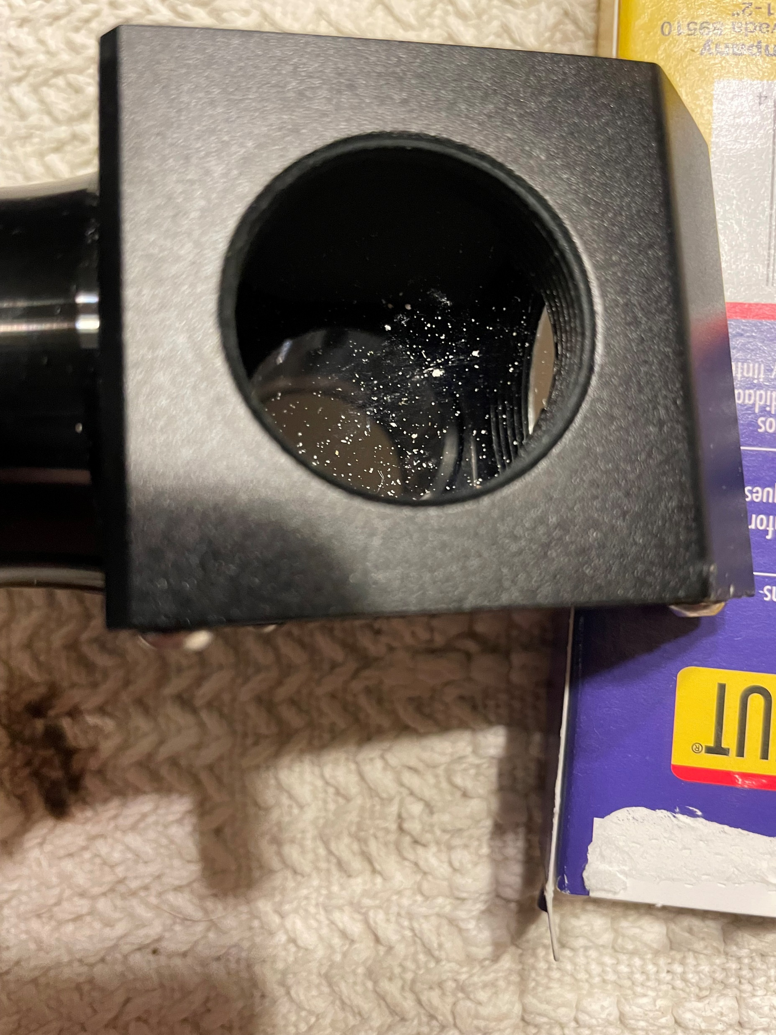
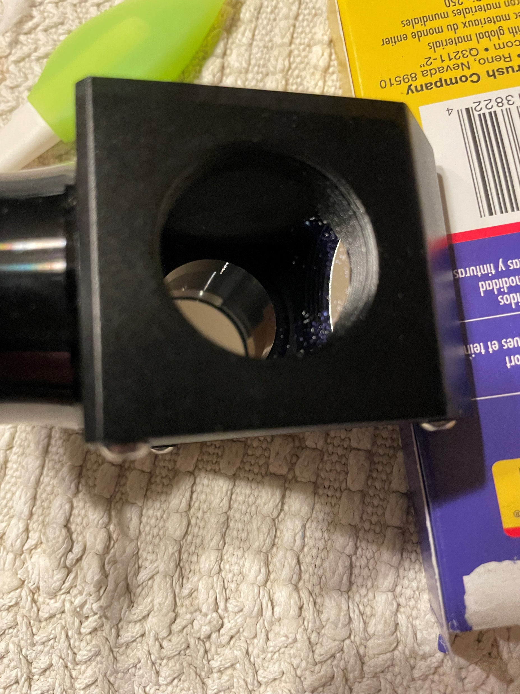
Before and After cleaning
Diagonal mirror before
Diagonal mirror after

Slide 6
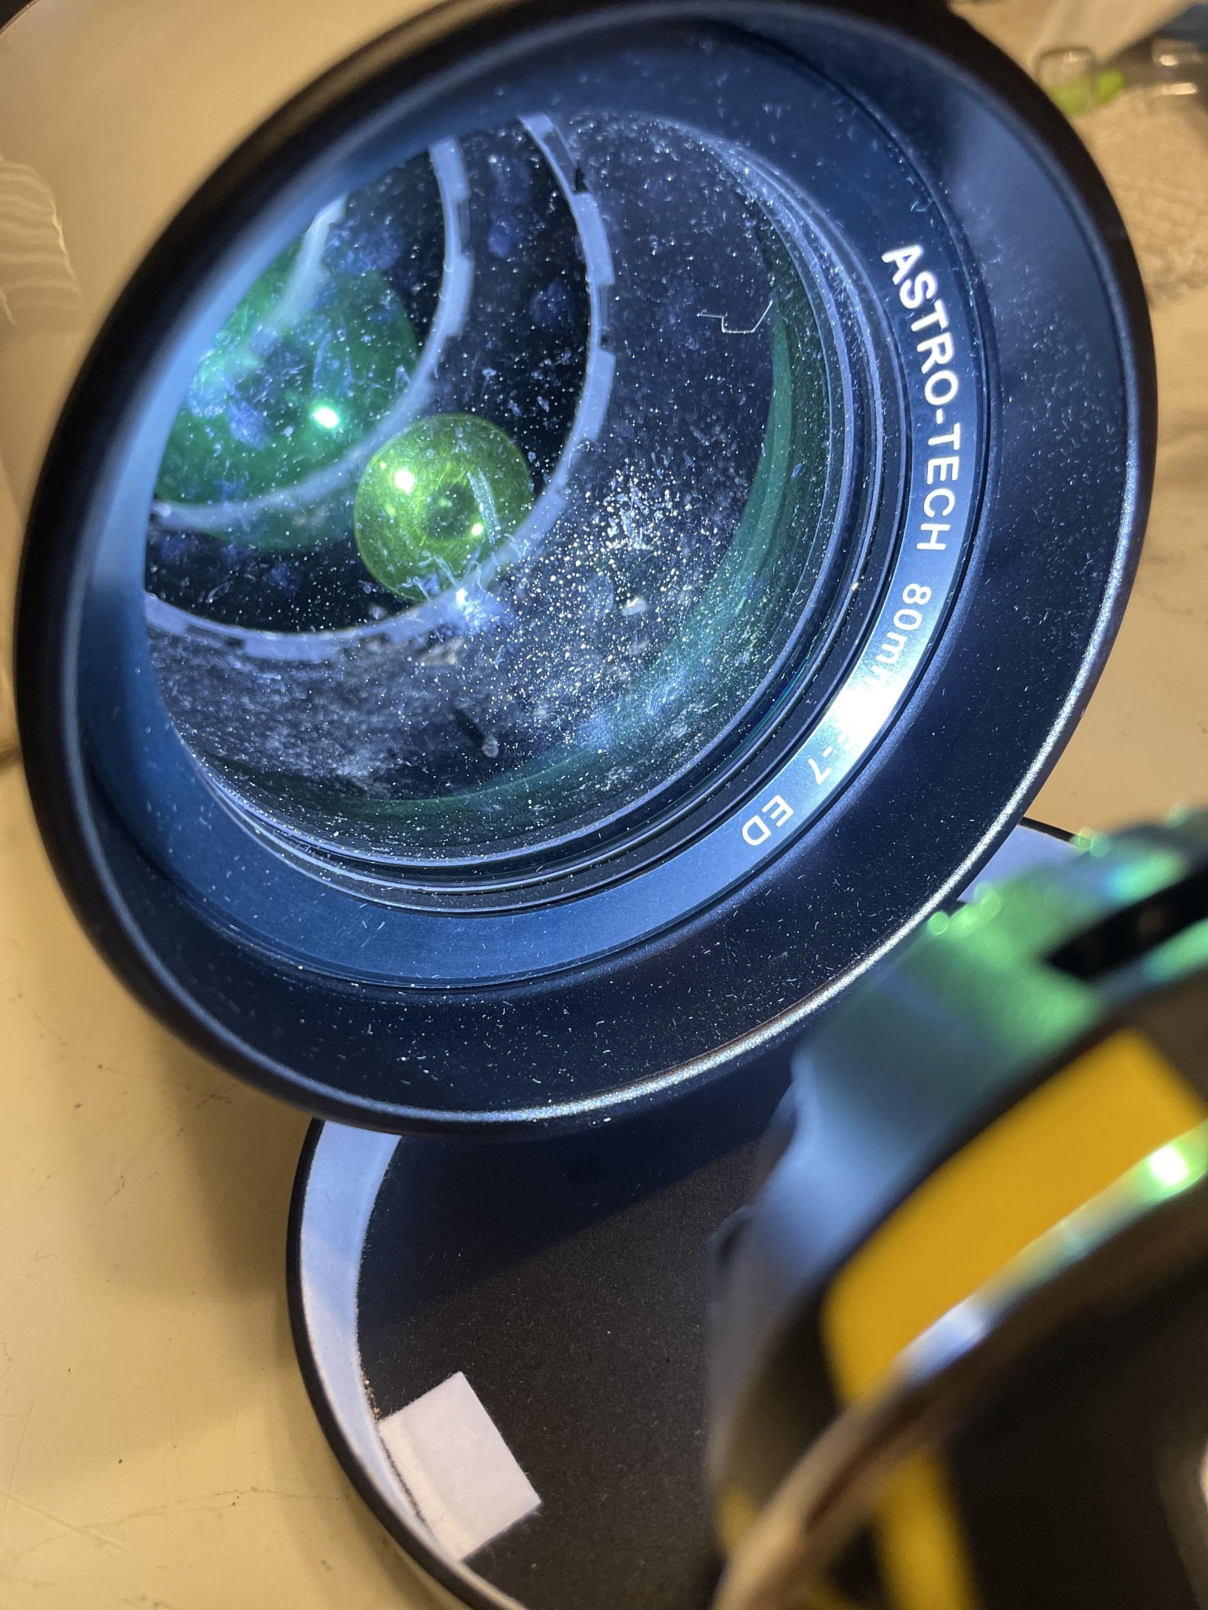
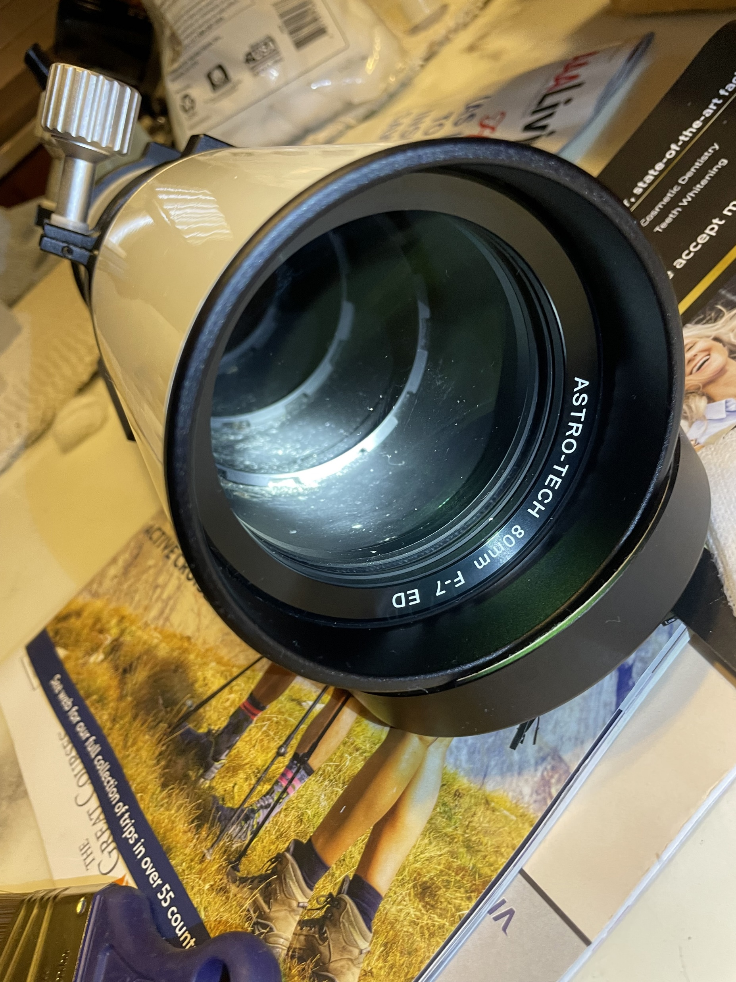
Before and After Cleaning
80 mm Apochromatic Lens before
80 mm Apochromatic Lens after

Slide 7
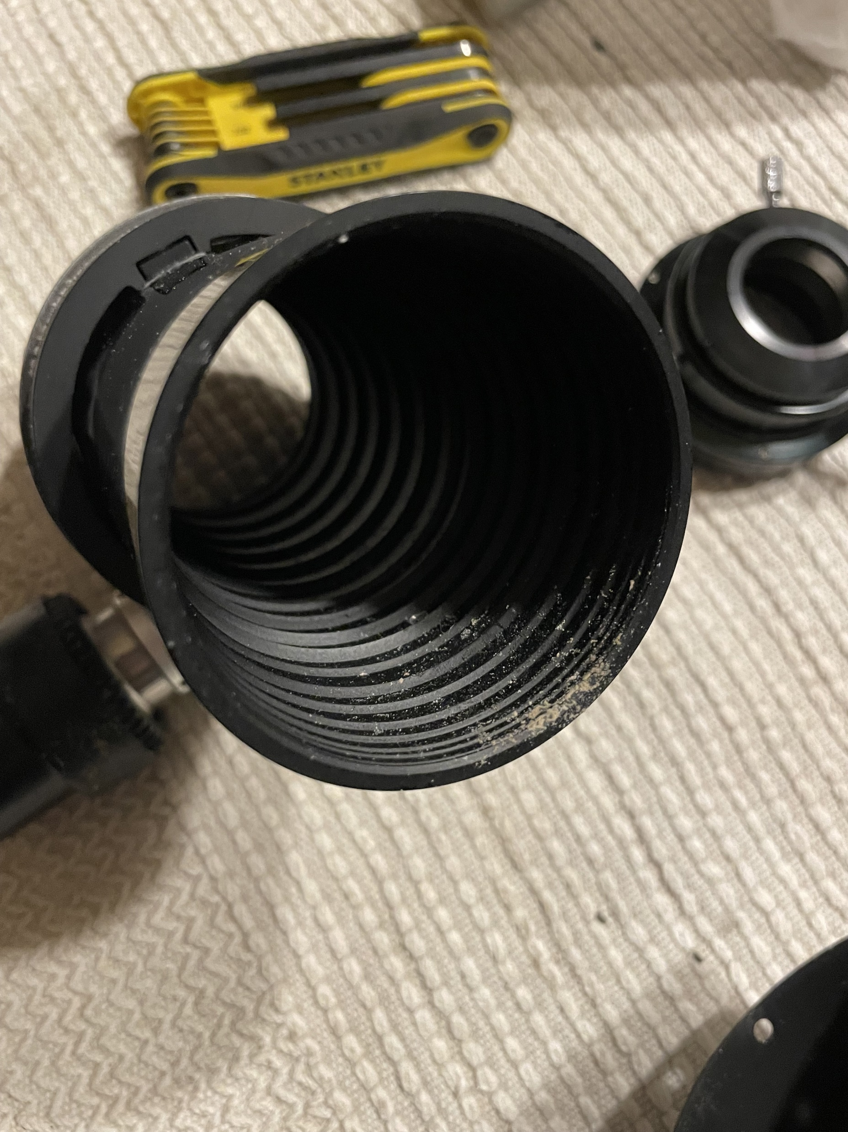
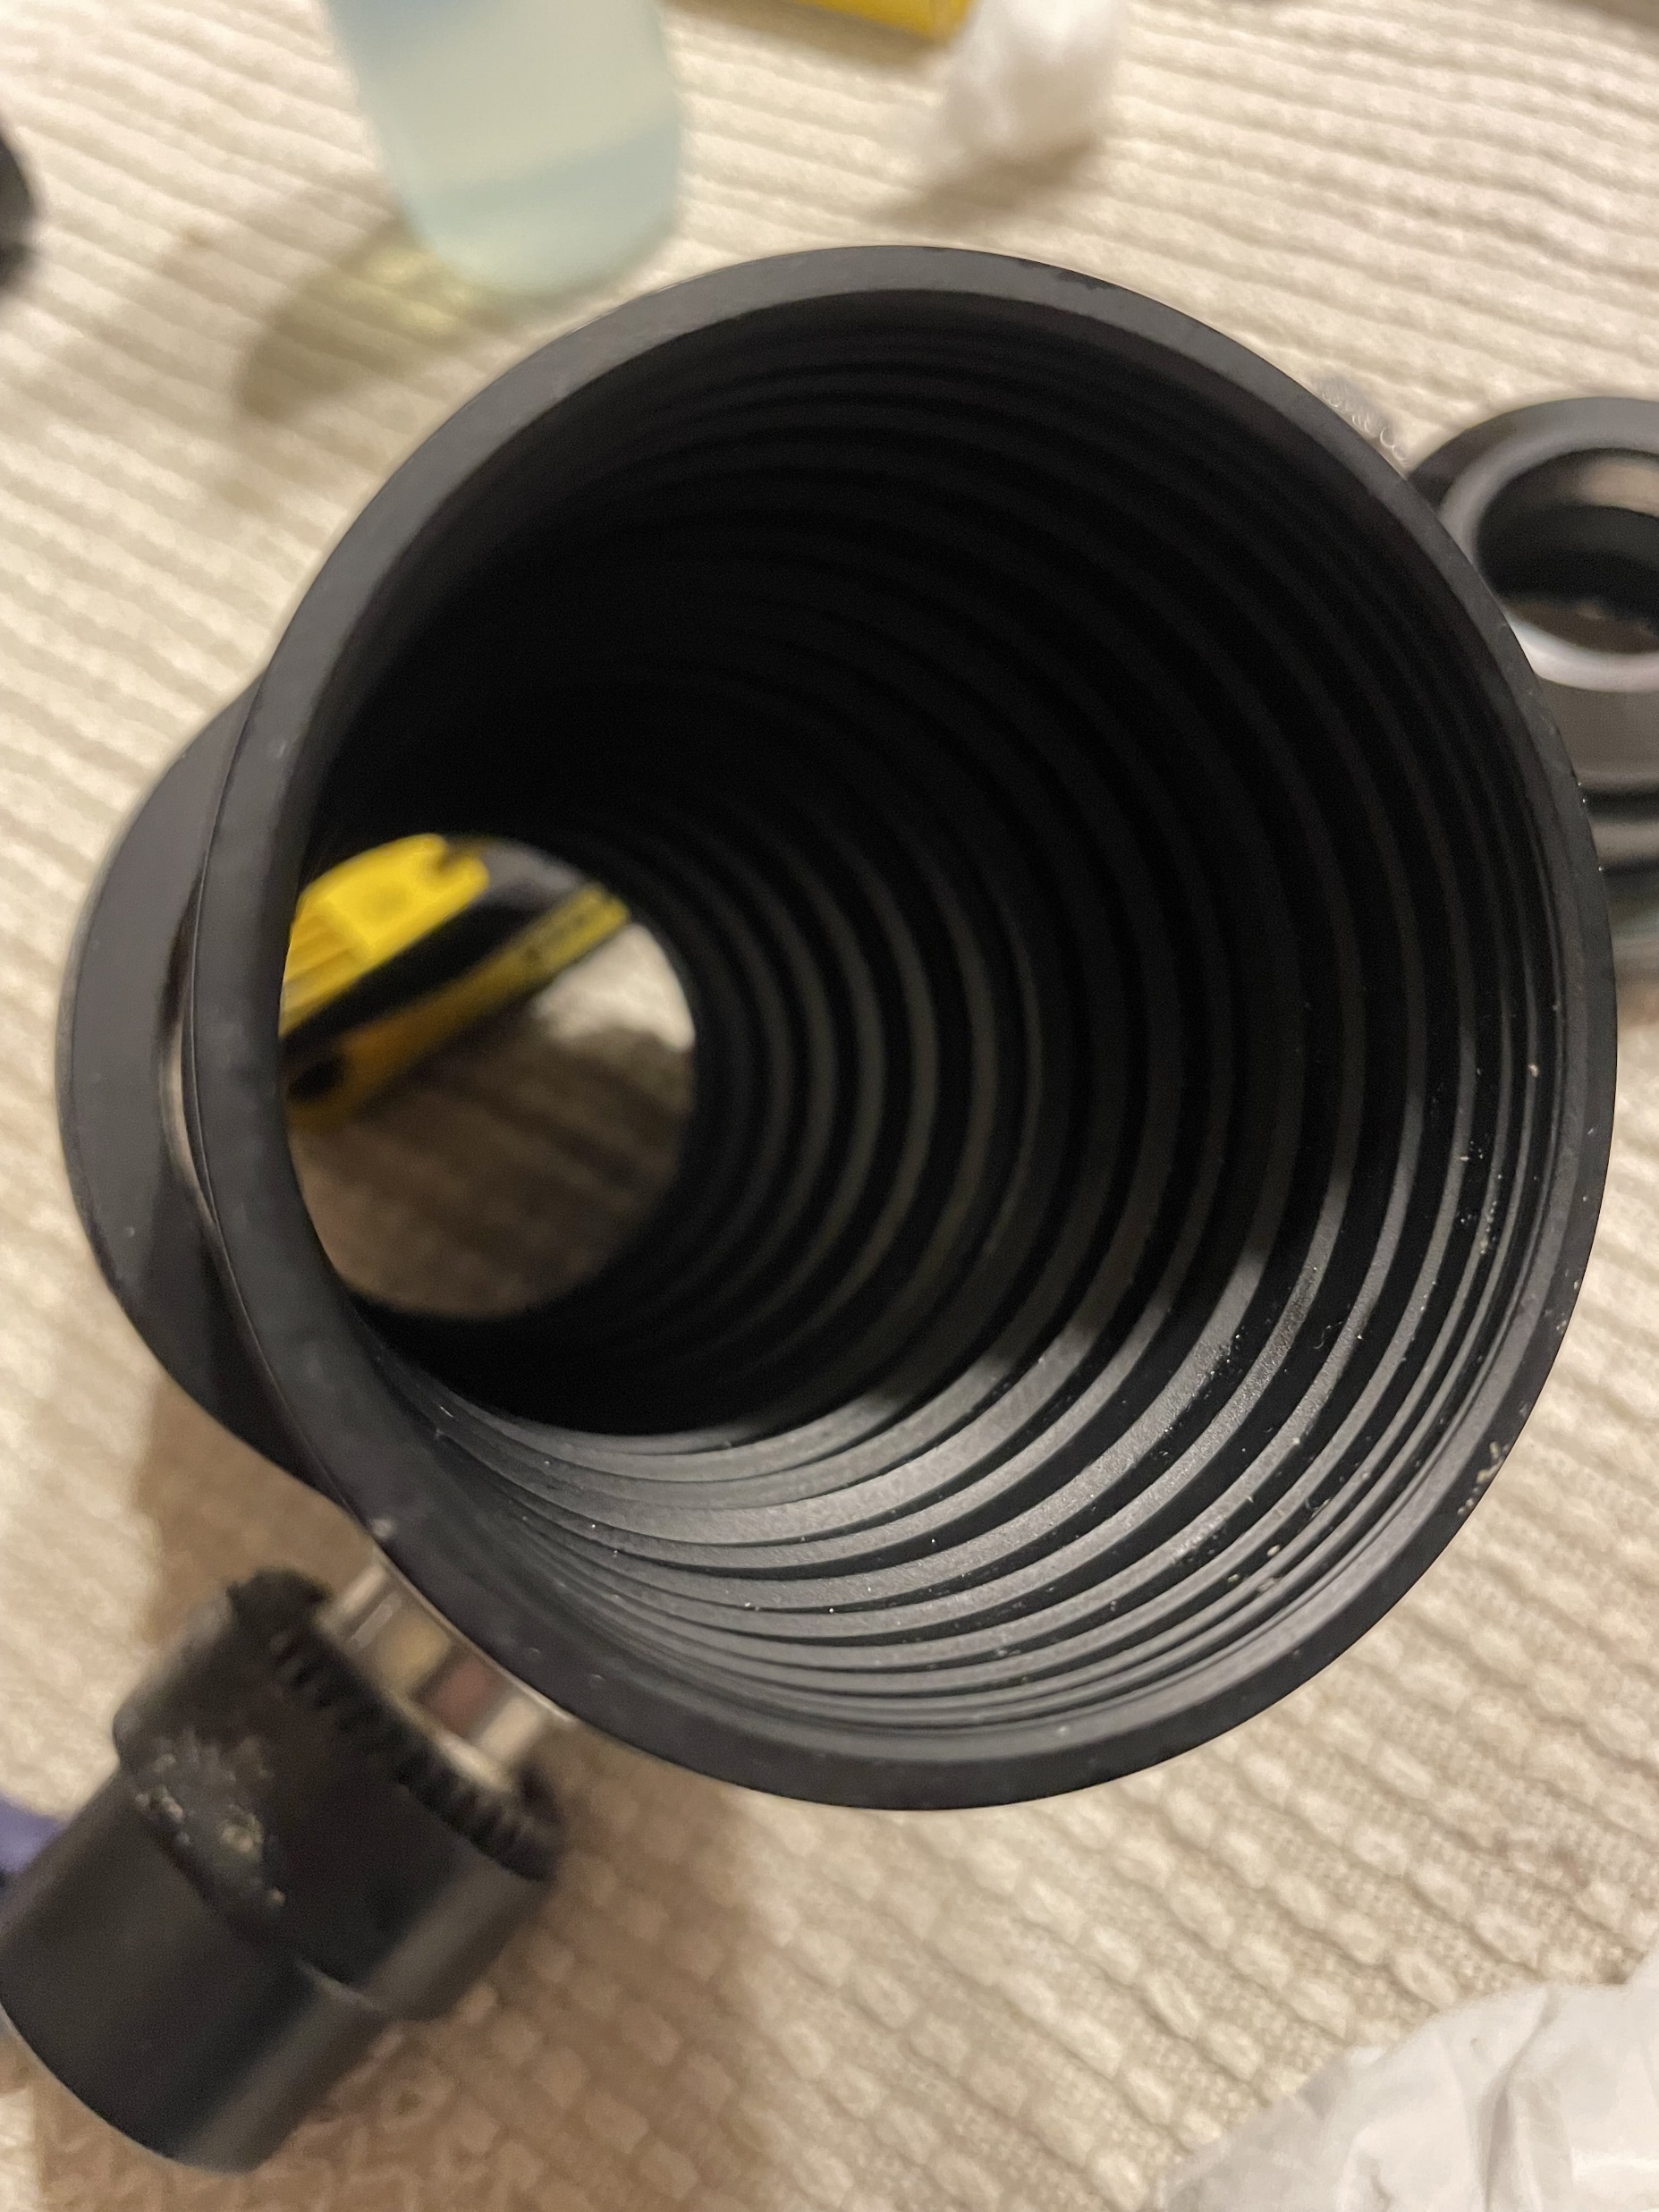
Before and After Cleaning
Optical tube baffles before
Optical tube baffles after

Slide 8
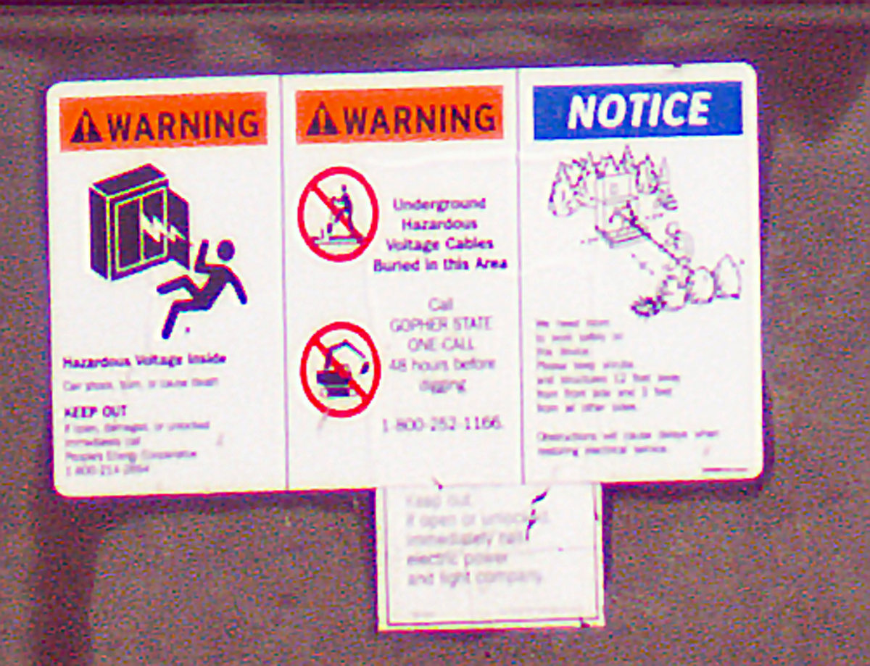
Observations after cleaning
The first observations were of terrestrial objects (like this distant sign imaged with Orion 6 Mpixel camera.
Visually (via a 7mm orthoscopic eyepiece) objects were a bit sharper

